Slide 1
STATS 608 Final presentation: Bayesian time-series for mobile health
Andrej Leban & Luke Francisco
April 2024

Slide 2
Problem motivation
We wish to address two common issues in mobile health data (such as smart watch measurements):
  Imputation - missing measurements
  Prediction - either subject dropout OR for real-time performance reasons
We wish to take advantage of flexible Bayesian structural time series methods that account for variation between the subjects
We evaluate these (potentially) complex models using Hamiltonian Monte Carlo, specifically the No-U-Turn Sampler implemented in PyMC
Notes:
Explain performance

Slide 3
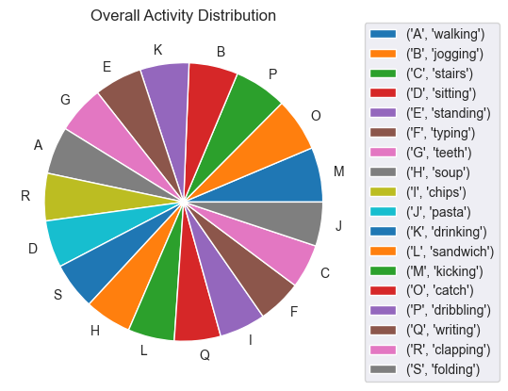
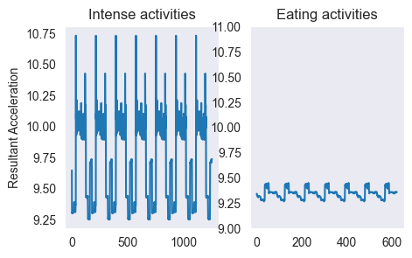
The data
WISDM Smartphone and Smartwatch Activity and Biometrics Dataset: accelerometer & gyroscope measurements collected with smartphone & watch during 18 different activities across 44 subjects
Significant differences between different activities & across subjects
Due to privacy issues, no personal characteristics available

Slide 4
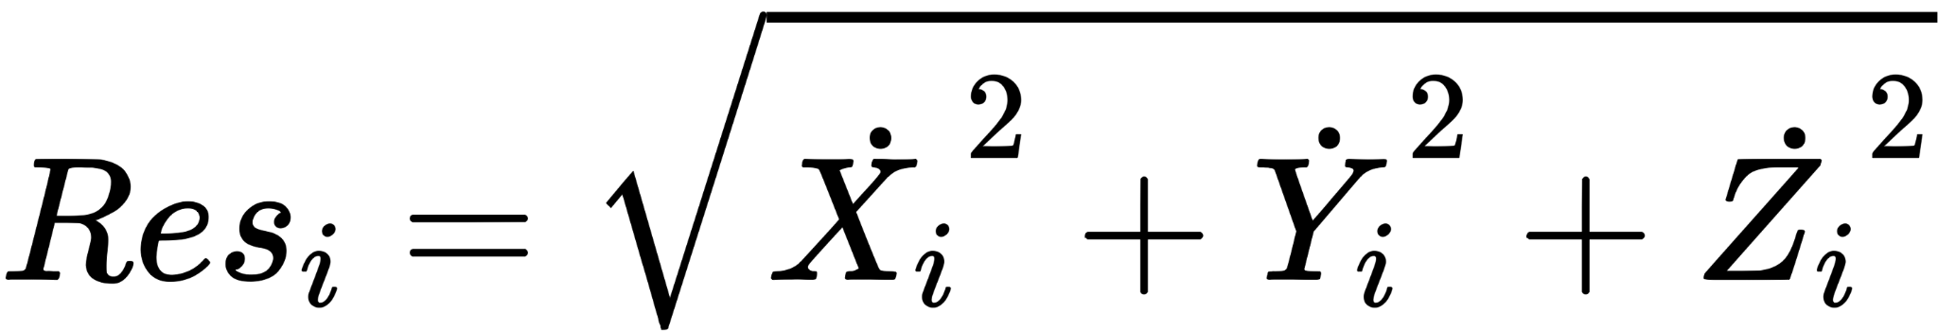
Modeling approach
For this reason, we derive static covariates from the low-activity data (such as eating), such as: overall averages of the time-series measurements, the averages of the peaks, the per-person minutes of activity logged, the entropy of the measurement distributions within a time window
These should be a good indicator of a person’s intrinsic activity level
We then make use of them to model each high-activity time series conditionally on the person and activity performed
For this project, we focus on the accelerometer resultant as our outcome:

Slide 5
The models
We use AR(1), AR(2), and AR(3) structural models
For prediction, we use the following model:
where X are the derived static covariates, and p is the AR order
For imputation, we also use concurrent measurements of other available quantities Z:
We mostly use standard normal / half normal priors

Slide 6
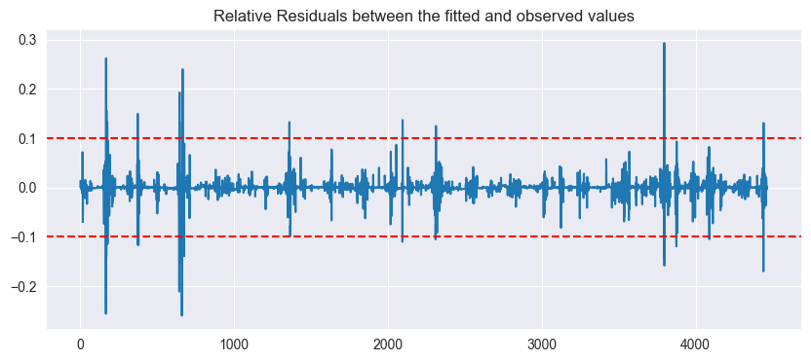
Results - overall fit for AR(1)
Mostly under 10% relative error!

Slide 7
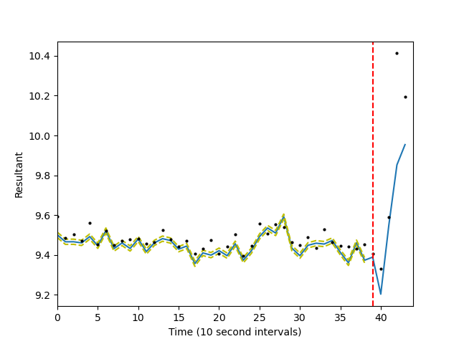
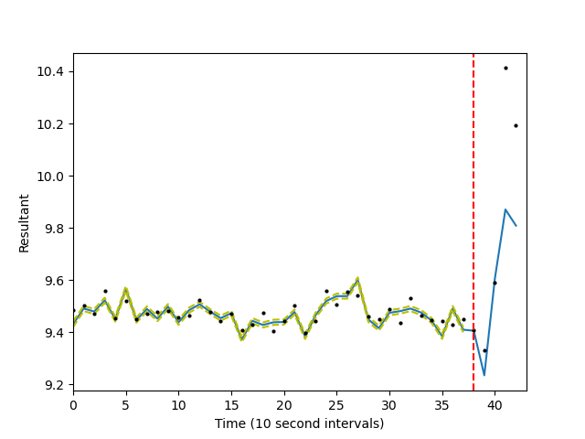
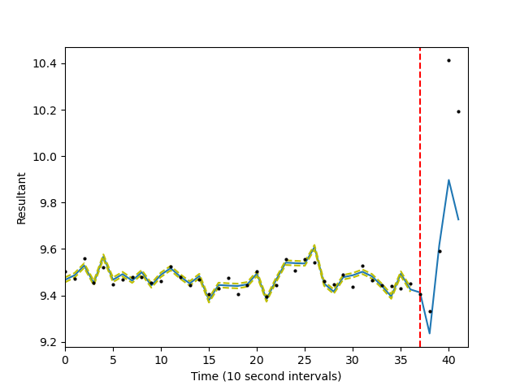
Results - imputation: AR(1), AR(2), AR(3)
same subject & activity across all plots. We withhold the last 5 points, but use future values of other measurements

Slide 8
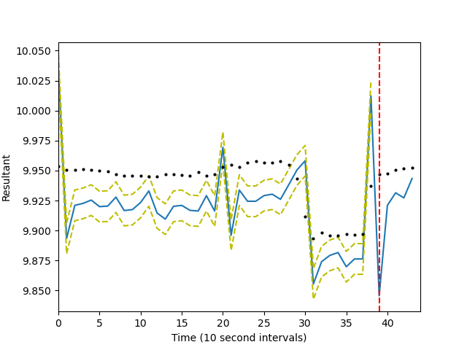
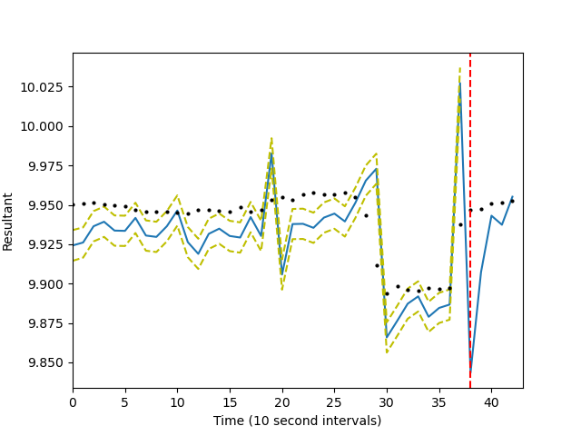
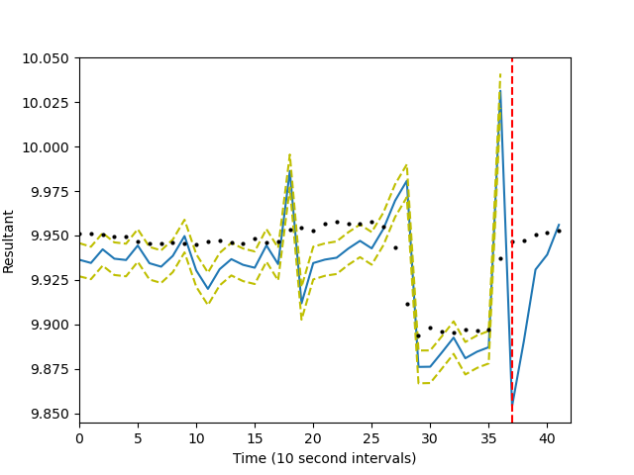
Results - imputation AR(1), AR(2), AR(3) cont’d

Slide 9
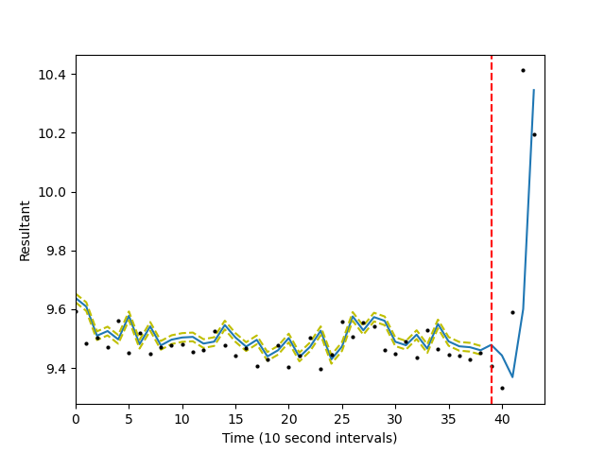
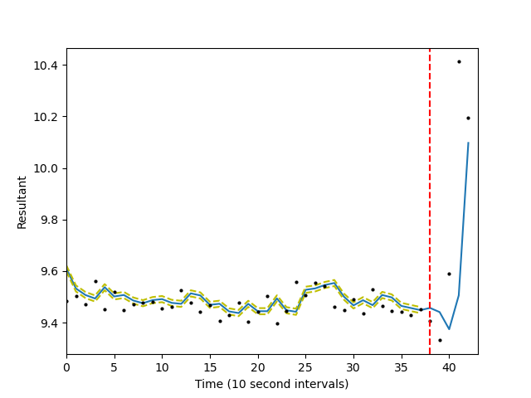
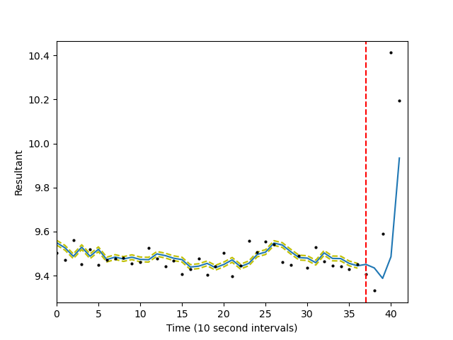
Results - prediction AR(1), AR(2), AR(3)

Slide 10
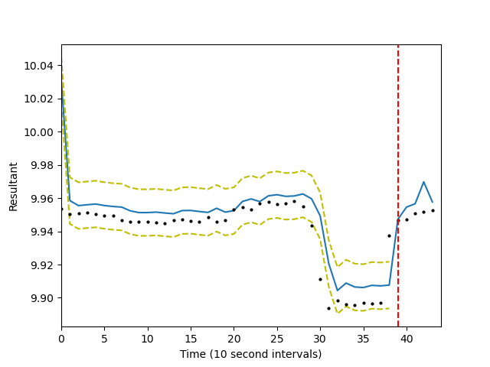
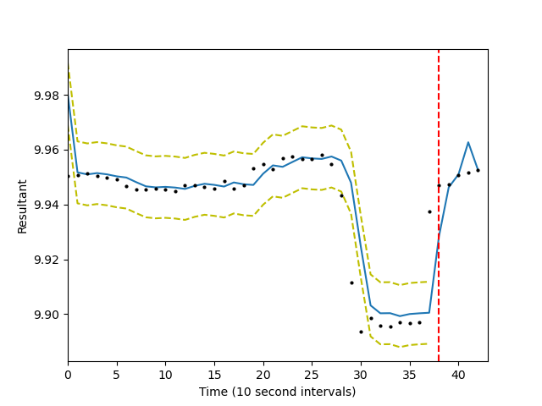
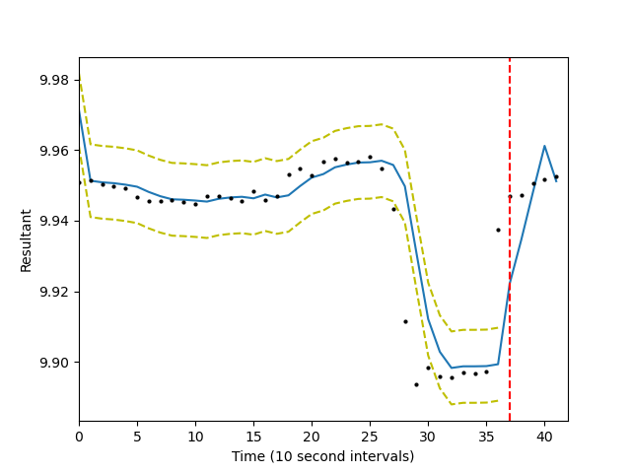
Results - prediction AR(1), AR(2), AR(3)

Slide 11
Conclusions
Even relatively low-order AR processes, helped by structural factors and a suitable choice of priors, achieve very good “fit” of the observed data
Likewise, imputation and prediction perform very well even with such relatively simple models
However, there are indications that the generating process for such data might be more complex than assumed, as hinted at by the “spikes” in activity the models struggled with
These results seem promising for more involved mobile health data sets where good imputation is currently a stumbling block for downstream tasks

